Slide 1

MIRACLE EDUCATIONAL SOCIETY GROUP OF INSTITUTIONS
(AUTONOUMOUS)
Approved by AICTE ,Accredited by NAAC & Permenantly Affiliated to JNTU-GV,VIZIANAGARAM-535216
Solar –Based Wireless Charging Station For Electric Vehicles
DEPARTMENT OF ELECTRONICS AND COMMUNICATION ENGINEERING
Presented By:
Ch.Vandana (226C1A0410)
K.Amrutha (226C1A0426)
S.Navaneeth (226C1A0451)
Ch.Abhishek (226C1A0411)
Under The Gudiance
Dr.A.Venkateswara Rao
Associate Professor
ECE Department

Slide 2
Abstract
The environmentally friendly vehicle is the global trend in the automobile industry. Compared to fuel vehicles, electric automobiles are the most environmentally beneficial option.
The commercialization of electric vehicles is limited by their massive capacity, weight, high price, short battery life, and long charging times.
An electric vehicle with wireless charging eliminates these concerns.
solar powered wireless auto charging for electric vehicles has been offered as a viable alternative to decreasing oil use, air pollution emissions, and electricity costs

Slide 3
Objectives
To develop a model that may be used to simulate solar powered electric vehicle charging and to save electricity and money by using solar power to charge an automobile wirelessly.
To developed Wireless car charging using solar to improve the environment by reducing pollution, facilitating connectivity, and simplifying handling
To save electricity and money by using solar power to charge an automobile wirelessly

Slide 4
Problem Statement
1. Lack of accessible EV charging stations.
2. Dependence on traditional energy sources.
3. Fear of battery depletion among EV users.

Slide 5
Solution Overview
To Designing a wireless charging station powered by solar energy.
To develop a model that may be used to simulate solar powered electric vehicle charging and to save electricity and money by using solar power to charge an automobile wirelessly
The system uses Arduino NANO for control and efficient energy transfer.

Slide 6
System Block Diagram

Slide 7
METHODOLOGY
The wiring diagram for project: when exposed to sunlight, the first solar panel generated up to 12 volts. The generated voltage is sent to the bridge rectifier since it stabilizes the voltage. The filtered voltage is applied to the battery to charge it.
A 6-volt, 4-amp battery is being used. The battery will be charged, and the energy will be stored. A wireless transmitter attached to a battery sends the produced magnetic field around the coil.
We can display the voltage using an Arduino NANO and a 16x2 LCD. The coil on the receiver side generates magnetic fields, and the voltage is in AC format.

Slide 8
A voltage sensor is connected to the battery, which displays the battery and solar voltages. This also shows both alternatives, such as the remaining battery power.
It converts AC to DC and thereby stabilizes the voltage. This voltage is applied to the battery in the car, which stores energy and charges it.
An LED indicator shows how much charge is left in the battery.

Slide 9
Hardware components
Solar panel used as an electric energy source.
Bridge Rectifier used for converting pulsating AC into DC.
Battery used as to store electric energy.
Arduino NANO is use for power consumption and to show it on the display

Slide 10
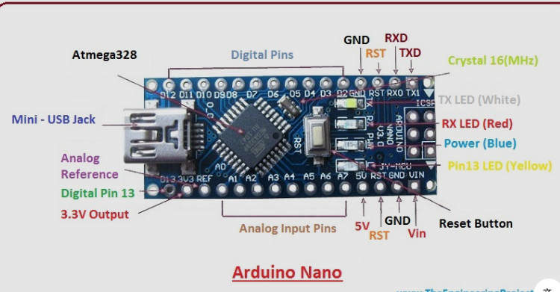
Arduino NANO
The Microchip ATmega328P microprocessor serves as the basis for the Arduino nano.
The board includes 14 digital I/O pins (six capable of output PWM), 6 I / O analogs, and configured via Arduino IDE (Integrated Development Zone), with a USB cable type B.
Although it accepts volumes of between 7 and 20 volts, It can be powered by a USB cable or an external 9-volt battery. Same with Leonardo and Arduino Nano.

Slide 11
Solar Panel
In order to better support the structure of the panels, solar panels also utilize metal frames that include items for mounting racks, brackets, reflector shapes, and tunnels. We used a 16w/12v, 1.5A solar panel in this case.
Solar cell or solar panel, a set of photo-voltaic cells embedded in the input frame. To produce direct current electricity, solar cells use sunlight as a source of energy.
A system of photovoltaic panels is called an array, and a photovoltaic panel is a collection of photovoltaic modules.
In a photovoltaic system, an array provides electrical items with solar energy.

Slide 12
Based on the thin film cells which are available, many modules are strong but slightly flexible.
To increase energy, cells are often electrically connected in a series, one to another at the desired voltage, and then in combination.
Solar panel production specs are provided under ordinary situations, which is not the actual operating situation of the solar panels exposed in the installation area.

Slide 13
Power Transmission system
The technology relies on inductive coupling to transfer energy between a transmitter and receiver.
Wireless Power Transmission(WPT) OR Wireless Energy Transfer(WET) Transfers Electrical Power from transmitter to receiver without wires.
In a wireless power transmission system, a power from a power source, produces a flexible electric field, which transfers energy from the transmitter to a receiver, which supplies energy to the field and supplies electricity.

Slide 14
Wireless transmission technology can eliminate the use of cables and batteries, thereby increasing the mobility, comfort, and safety of the entire electrical system.
Wireless power transfers help to supply power to electrical appliances when connecting cables are faulty, dangerous, or ineffective.
Wireless transmitter convert DC to pursuiting AC and generates magnetic field and Wireless receiver convert pursuiting AC to DC and generates magnetic field.

Slide 15
Steps for Wireless Charging
1. Vehicle detection using sensors.
2. Energy transfer activation.
3. Monitoring and display on LCD.

Slide 16
Wireless Charging
How Mutual Induction Works in Wireless Charging?
Primary Coil (Transmitter Side):
Connected to a power source (solar + battery).
Converts DC to high-frequency AC using an inverter circuit.
Generates an alternating magnetic field around the coil.
Secondary Coil (Receiver Side - In EV):
Placed under the vehicle or inside the charging system.
When positioned near the transmitter coil, mutual induction occurs.
Induced AC voltage is converted back to DC and used to charge the battery.

Slide 17
Thank you

